Slide 1



Workforce Management
Automation
03/12/2024
Workforce
Management
Transformation

Slide 2





Playwright Introduction
Playwright is a
Cross-browser
Cross-language
(Open Source) Web Testing and Automation Framework
Cross-platform
…by Microsoft
…and the people who made Puppeteer
https://github.com/microsoft/playwright
https://playwright.dev/

Slide 3





Why Playwright?
01
Dependable
02
Efficient
03
Capable
04
Ubiquitous
05
Delightful
06
Lively
Source: https://www.slideshare.net/Applitools/playwright-a-new-test-automation-framework-for-the-modern-web

Slide 4







Playwright Architecture
JavaScript
Java
Python
Language Bindings
C#
Single Automation Protocol
Unify all debugging protocols
Common Driver API
(Native) browser debugging protocols,
e.g. ChromeDevTools Protocol, (Safari) Web Inspector
Chromium
Webkit
Firefox
OS: Windows, Linux, macOS

Slide 5
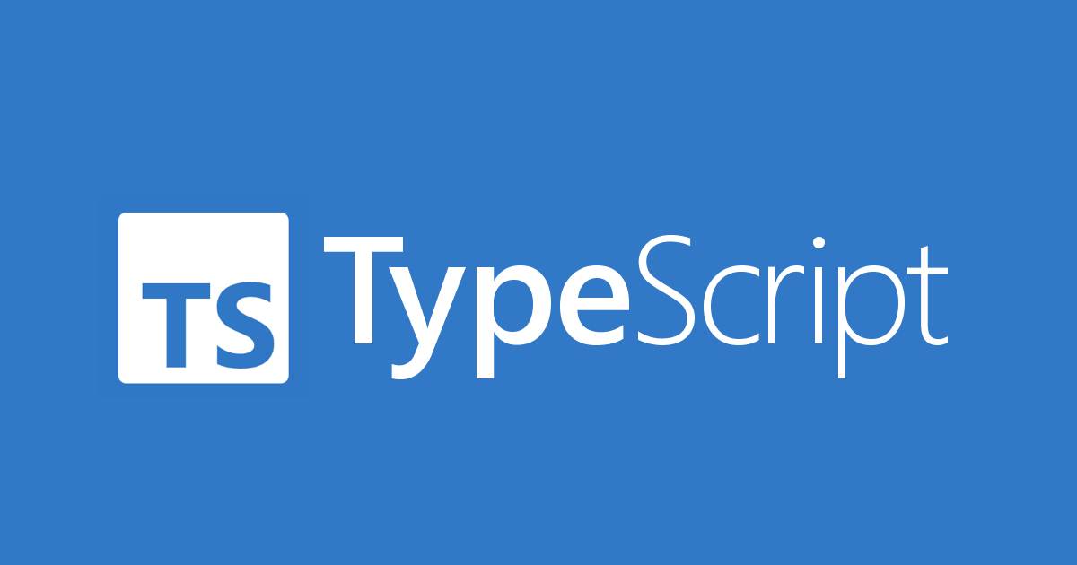

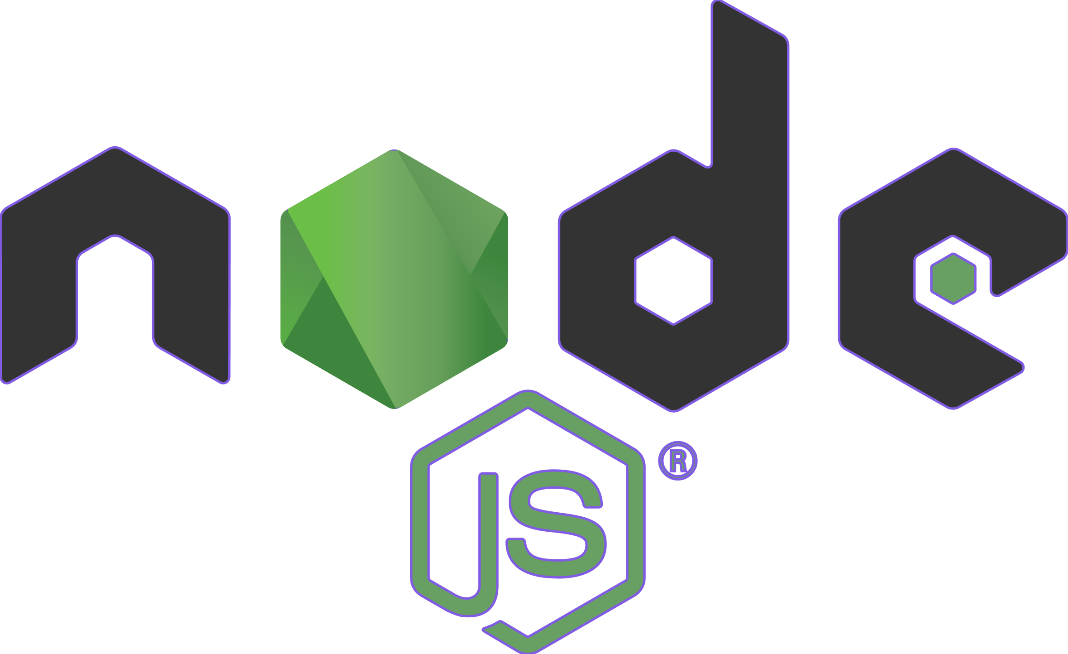


WFM Automation solution
Client
Browsers
server
Page Objects
Configs
Libraries & Utils
Test Data
Test Execution
Test Results
WebSocket Connection
Web Application Under Test
Playwright

Slide 6





Framework Tech Stack
Automation Framework Tech Stack
Custom Java Libraries – Modular reusable components
Tokenisation
Schema Validation
Payload generation
Data – Data is passed from Excel
Script data passed as part of POM approach.
Provision to generate & use dynamic data on the fly.
Configuration – Configuration files
Environmental Parameters, URLs
Playwright
Tool for testing Web Application
Tool for test Restful webservices
Extent Reports
Provides detailed test results and metrics in intuitive format
Playwright Framework
Page Objects/Custom
JS/TS Libraries
Data
Config
Playwright Tests
Test Reporting

Slide 7
Scope and Coverage
Milestone | Target | Build | DryRun | Dataset
Schedule Import (import) | 10/05/2024
Schedule Rule Validation | 24/05/2024
Adding Schedules (front end) | 30/04/2024
Adding Paycodes (Enter Time Off) | 31/10/2024
Validate Payroll Output | 13/11/2024
ESS Requests | 31/10/2024
Reports & Dataviews per Persona | 11/11/2024
Timecard Totals | 28/06/2024
Job Transfer Set (Workday) | 08/10/2024
Timecard Punches | 03/06/2024
Timecard exceptions | TBD
Timecard Premiums | TBD
Overtime Approval | TBD
Persona Access (TBD) | TBD
Clock testing (TBD) | TBD

Slide 8
Quick Start Guide
Pre-requisites
Install NodeJS. Download from https://nodejs.org/) and download the latest LTS version.
Install Visual Studio code as IDE for TS and JS. Download from https://code.visualstudio.com/
Playwright Installation
Navigate to desired drive on your computer and create a new folder for Playwright (ex: PlaywrightJSFramework).
From Visual Studio Code, Navigate to File> Open > Choose the newly created folder (PlaywrightJSFramework).
Enter the command npm init playwright@latest. Playwright will get installed and will create the following files
playwright.config.ts package.json package-lock.json tests/ example.spec.ts tests-examples/ demo-todo-app.spec.ts
The tests folder contains a basic example test to help you get started with testing.
For a more detailed example check out the testsexamples folder which contains tests written to test a todo app.
Test Execution and Reporting
npx playwright test
npx playwright show-report

Slide 9


Workforce
Management
Transformation
MAY THE WORKFORCE BE WITH US…
Notes:
This is the end-slide closing a presentation – always. Includes animation.

